Slide 1
The IADR is a nonprofit organization with a mission to drive dental, oral, and craniofacial research for health and well-being worldwide. IADR represents the individual scientists, clinician-scientists, dental professionals, and students based in academic, government, non-profit and private-sector institutions who share our mission.

Slide 2
IADR Values
Scientific Excellence IADR values science conducted at the highest possible levels of rigor, innovation and ethics, across disciplines, from discovery science to clinical implementation to global population health.
Social Responsibility IADR values the pursuit of science to improve health and well-being for all people, to reduce health inequalities and inequities, and proactively takes actions and positions to improve health.
Scientific Community IADR values a diverse and inclusive scientific workforce, promotes work-life balance, and supports educational activities and mentoring networks to develop the next generation of scientists.
Notes:
The IADR Core Values are: Excellence, Responsibility and Community.

Slide 3
Expanded Name & New Logo
As part of the 2023 IADR/LAR General Session & Exhibition with WCPD Opening Ceremonies, IADR announced the expansion of our name to the International Association for Dental, Oral, and Craniofacial Research.
This will better encompass IADR’s members’ breadth of science and presenting IADR as an inclusive community for all scientists committed to driving dental, oral, and craniofacial research for health and well-being worldwide.
The three shades of blue in the new logo represent dental, oral, and craniofacial research – the domains upon which our organization is based – and the simplified design achieves a more modern feel as IADR moves into its next century.

Slide 4
IADR Regional Structure
IADR
NAR
LAR
APR
PER
AMER
East & Southern African
Iranian
Iraqi
Kuwaiti
Nigerian
Saudi Arabian
South African
Egyptian
Jordanian
Lebanese
Libyan
Palestinian Qatari
Sudanese
Syrian
Tunisian United Arab Emirates
ANZ Chinese
Indian
Japanese
Korean
SEA
Mongolian
Pakistani
Argentine
Brazilian
Chilean
Colombian
Peruvian
Uruguayan
Venezuelan
Bolivian Caribbean Costa Rican
Ecuadorian
Guatemalan
Panamanian
Paraguayan
AADOCR
CADR
Mexican
British
CED
Irish
Israeli
Scandinavian
Russian
28 Divisions: Black 20 Sections: Blue

Slide 5
2023 IADR Membership by Region
PER
NAR
1,631
3,210
APR
2,175
AMER
586
LAR
939
Total Membership: 8,541
(as of November 1, 2023)

Slide 6
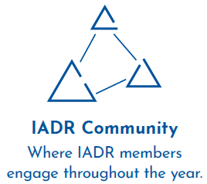
Membership Benefits
Notes:
An IADR membership offers many benefits including access to the online IADR Community, IADR Webinar & CE On Demand Library, publications, discounts on meeting registrations, presentation and awards/fellowship opportunities, access to the abstract archive, the Global Research Update newsletter, membership in IADR Scientific Groups or Networks and much more.

Slide 7
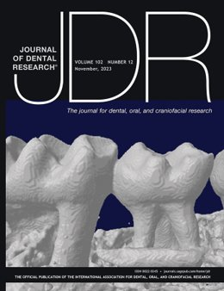
Journal of Dental Research
Editor-in-Chief: Nicholas Jakubovics
Journal Citation Reports™ results for the JDR:
2-year Journal Impact Factor™: 7.6, ranking #3 of 91 journals
5-year Journal Impact Factor™: 7.6, ranking #5 of 91 journals
Eigenfactor: 0.01345, ranking #3 of 91 journals
Total citations: 25,849, ranking #1 of 91 journals
Article Influence Score: 1.638, ranking #5 of 91 journals
Journal Citation Indicator: 2.86, ranking #3 of 156 journals
Published manuscripts appear in print and OnlineFirst, by which forthcoming articles are published online before they are scheduled to appear in print.
www.iadr.org/jdr
Follow the JDR on Twitter @JDentRes!

Slide 8
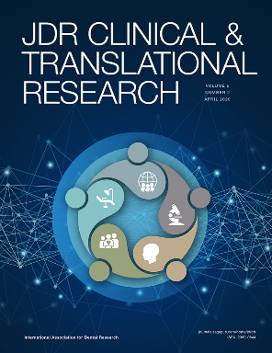
JDR Clinical & Translational Research
Editor-in-Chief: Jocelyne S. Feine
JDR Clinical & Translational Research received its first Journal Impact Factor™ in 2023!
Journal Impact Factor™: 3.0
Eigenfactor™: 0.00148
Immediacy Index: 0.500
Journal Citation Indicator: 1.07
Total 2022 citations: 786
Average time from submission to first decision: 29.8 days
Average time from acceptance to online publication: 41 days
www.iadr.org/jdrctr
Follow the JDR CTR on Twitter @JDRClinTransRes!
Notes:
MEDLINE, created by the U.S. National Library of Medicine (NLM), is the authoritative bibliographic database containing citations and abstracts in the fields of medicine, nursing, dentistry, veterinary medicine, health care systems and preclinical sciences from around the world and is used internationally by clinicians, researchers and policy makers to access the world's biomedical research literature. A distinctive feature of MEDLINE is that the records are indexed with the NLM Medical Subject Headings (MeSH®). MEDLINE is the primary component of PubMed® — a database with over 29 million citations for life sciences and biomedical literature.

Slide 9
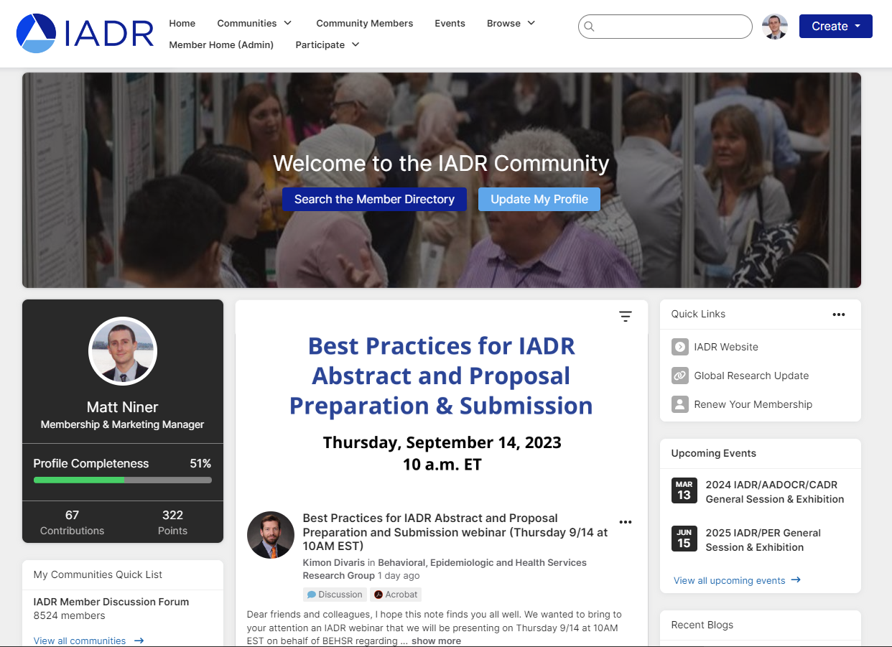
IADR Community
The IADR Community has been upgraded!
With a new design, a more intuitive interface, and improved search functionality, it’s now easier than ever for IADR members to engage throughout the year.
Notes:
Join the IADR Community. The IADR Community is an online hub to meet and discuss research and other topics with your colleagues.

Slide 10
IADR Awards and Fellowships
40+ awards and fellowships in various categories
Distinguished Scientist Awards: 17 categories
Student & Scientific Group Awards
IADR Hatton Competition
Junior
Senior Clinical
Senior Basic Science
Notes:
IADR has opportunities for members to be recognized for their research contributions through Awards and Fellowships. There are more than 40 awards and fellowships in various categories, including student awards. Visit the IADR website for the deadlines for the 2023 Awards and Fellowships.

Slide 11
IADR Webinar & CE On Demand Library
Attend live webinars where you can interact with speakers or view recordings of past webinars and cutting-edge presentations from IADR and AADOCR meetings.
Notes:
Attend live webinars where you can interact with speakers or view recordings of past webinars and cutting-edge presentations from IADR and AADOCR meetings. Members can submit a webinar proposal for consideration!

Slide 12
IADR Scientific Groups/Networks
Scientific Groups (25)
Behavioral, Epi & HSR
Cariology Research
Craniofacial Biology
Dental Anesthesiology and
Special Care Research
Dental Materials
Diagnostic Sciences
Education Research
Geriatric Oral Research
Implantology Research
Lasers & Biophotonics
Microbiology/Immunology
Mineralized Tissue
Networks (10)
Clinical and Translational Science
Digital Dentistry Research Network
e-Oral Health Network
Evidence-based Dentistry
Global Oral Health Inequalities Research
International Network for Orofacial Pain and Related Disorders Methodology (INfORM)
Minimally Invasive Dentistry Network
Network for Practice-based Research
Student Training and Research (STAR)
Women in Science Network
Neuroscience
Nutrition Research
Oral & Maxillofacial Surgery
Oral Health Research
Oral Medicine & Pathology
Orthodontics Research
Pediatric Oral Health Research
Periodontal Research
Pharmacology/Therapeutics/
Toxicology
Prosthodontics
Pulp Biology & Regeneration
Salivary Research
Stem Cell Biology

Slide 13
Support for Low and Middle-Income Countries (LMICs)
IADR Regional Development Program
IADR promotes oral health research worldwide with a specific emphasis on assistance and education. Since 1996, the Regional Development Program has distributed more than $1.3 million in funding to enhance capacity and infrastructure in regions with less developed research programs.
Awards and Fellowships
The IADR Centennial Travel Award for New Investigators, the IADR Newell W. Johnson Travel Award, and the IADR Smile Train Cleft Research Award offer funding specifically to members of LMICs to promote research development and attendance at the IADR General Sessions.
IADR Adopt-a-Member Fund
Donations to the fund directly support IADR Members and Student Members in LMICs in paying IADR annual membership dues and/or IADR General Session registration fees.
Tiered Dues and Registration Fees
IADR offers significantly discounted rates for individuals from LMICs on membership as well as for registration at the annual IADR General Session & Exhibition.

Slide 14
REGISTER TODAY!
Pre-registration deadline: February 1, 2024
Notes:
Visit www.iadr.org/events/upcoming-events for more information on future meetings.

Slide 15
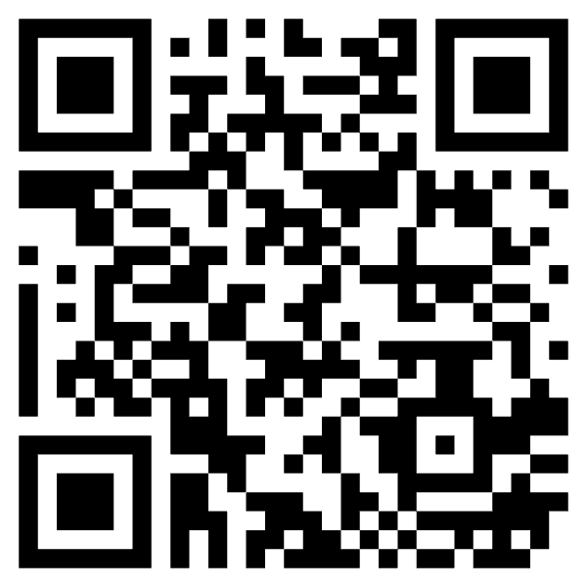
https://socialoffset.org/event/iadr24/
IADR is working with SocialOffset to make local impact in New Orleans. Scan the QR code to choose from local vetted charities and make a donation.

Slide 16
Future Meetings
Notes:
Visit www.iadr.org/events/upcoming-events for more information on future meetings.

Slide 17
Contact Us
Email us with any questions about IADR membership, journals, or meetings at research@iadr.org or give us a call at +1.703.548.0066. Visit us online at www.iadr.org.
Notes:
In closing, more information about the items I have covered is available on the IADR website. If you have questions, please feel free to contact the IADR Global Headquarters by phone or email.

Slide 18
Notes:
Follow IADR on social media!

