Slide 1
About Us

Slide 2
Our Mission
Drive dental, oral, and craniofacial research to advance health and well-being.

Slide 3
Our Vision
Oral health through discovery and dissemination.

Slide 4
AADOCR Values
Scientific Excellence: AADOCR values science conducted at the highest possible
levels of rigor, innovation and ethics, across disciplines, from discovery science to clinical implementation to global population health.
Social Responsibility: AADOCR values the pursuit of science to improve health and
well-being for all people, to reduce health inequalities and inequities, and proactively takes actions and positions to improve health.
Scientific Community: AADOCR values a diverse and inclusive scientific workforce,
promotes work-life balance, and supports educational activities and mentoring networks to develop the next generation of scientists.

Slide 5
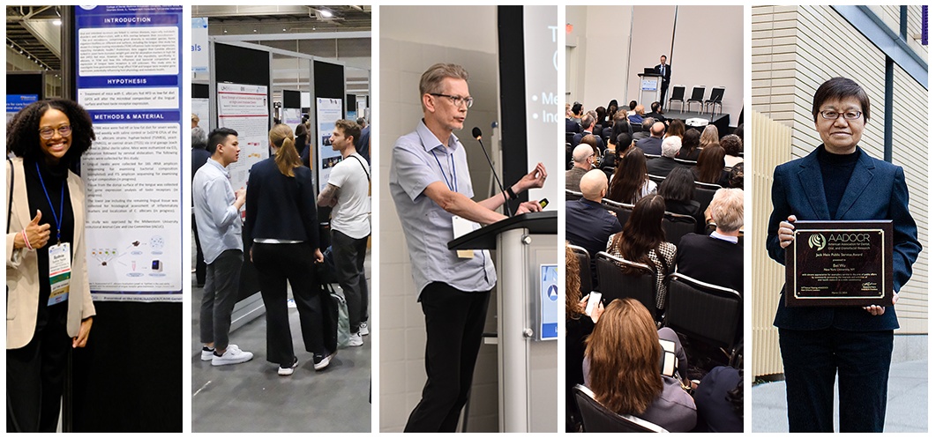
Membership
AADOCR is the leading professional community for multidisciplinary scientists who advance dental, oral, and craniofacial research.

Slide 6
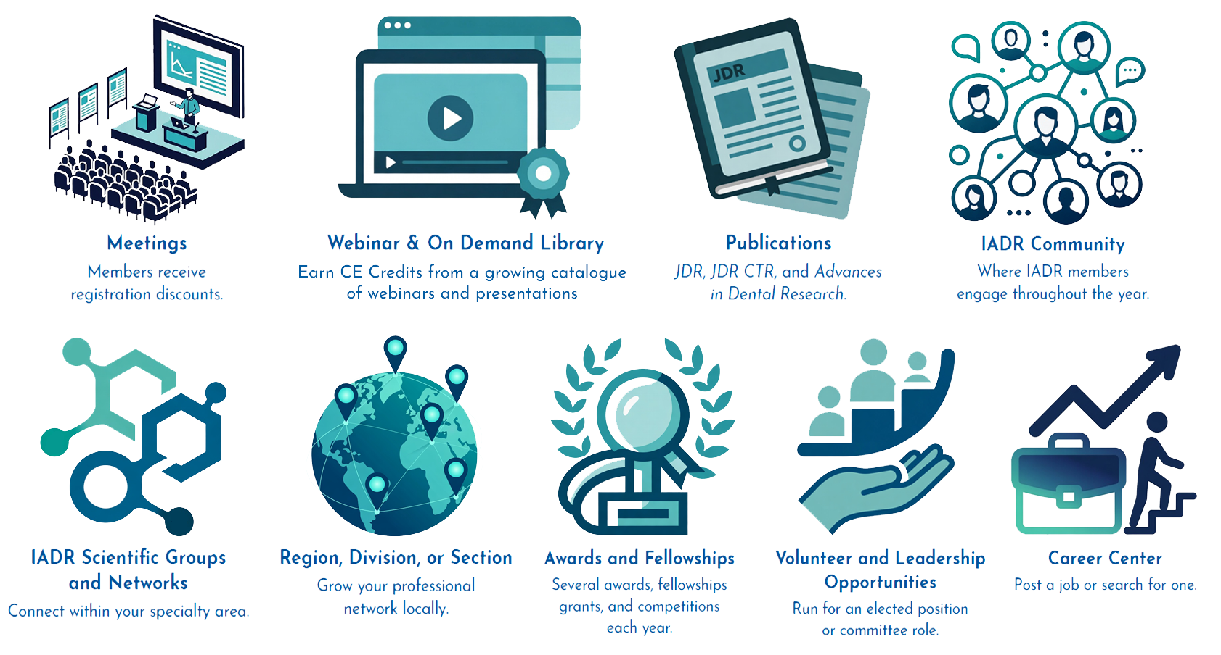
Membership Benefits
Notes:
An IADR/AADOCR membership offers many benefits including access to the online IADR Community and AADOCR Community, publications, advocacy, discounts on meeting registrations, presentation, and awards/fellowship opportunities, access to the IADR CE On Demand library and IADR Abstract Archive, the Science Advocate newsletter, membership in IADR Scientific Groups or Networks, and much more.

Slide 7
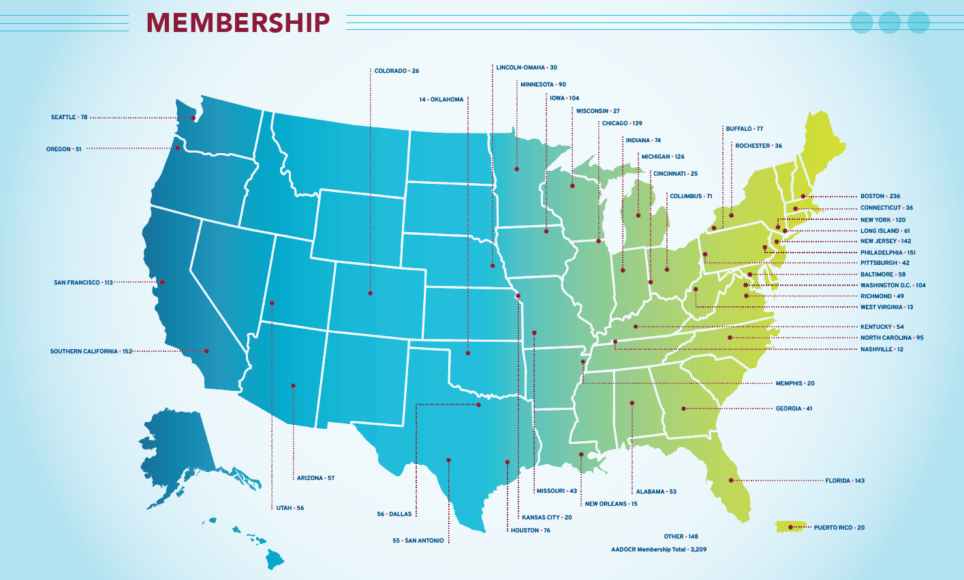
Membership Map
2025

Slide 8
Membership Breakdown
Members: | 1,395
Student Members: | 1,060
Retired Members: | 292
Affiliate Members: | 39
Total 2025 Membership: | 3,209

Slide 9
IADR Scientific Research Groups/Networks
Scientific Groups
Behavioral, Epi & HSR
Cariology Research
Craniofacial Biology
Dental Anesthesiology &
Special Care Research
Dental Materials
Diagnostic Sciences
Education Research
Geriatric Oral Research
Implantology Research
Microbiology/Immunology
Lasers & Biophotonics
Mineralized Tissue
Neuroscience/TMJ
Networks
Clinical and Translational Science
Digital Dentistry Research Network
e-Oral Health Network
Evidence-based Dentistry
Global Oral Health Inequalities Research Network
International Network for Orofacial Pain and Related Disorders Methodology (INfORM)
Minimally Invasive Dentistry Network
Network for Practice-based Research
Oral Malodor Network
Pride in Dental Research Network
Student Training and Research
Women in Science Network
Nutrition Research
Oral & Maxillofacial Surgery
Oral Health Research
Oral Medicine & Pathology
Orthodontics Research
Pediatric Oral Health Research
Periodontal Research
Pharmacology, Therapeutics &Toxicology
Prosthodontics Pulp Biology & Regeneration
Salivary Research
Stem Cell Biology
Notes:
This is a list of the IADR Scientific Groups and Networks. IADR/AADOCR members may enjoy complimentary membership in one IADR Scientific Group or Network and Student members can join up to three IADR Scientific Groups or Networks as part of their Student membership. Please be active in at least one.

Slide 10
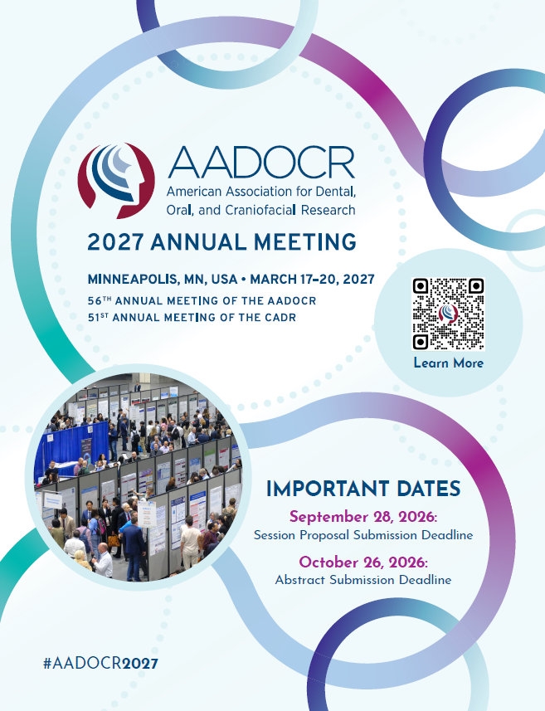
IMPORTANT DATES
September 28, 2026
Session Proposal Submission Deadline
October 26, 2026
Abstract Submission Deadline

Slide 11
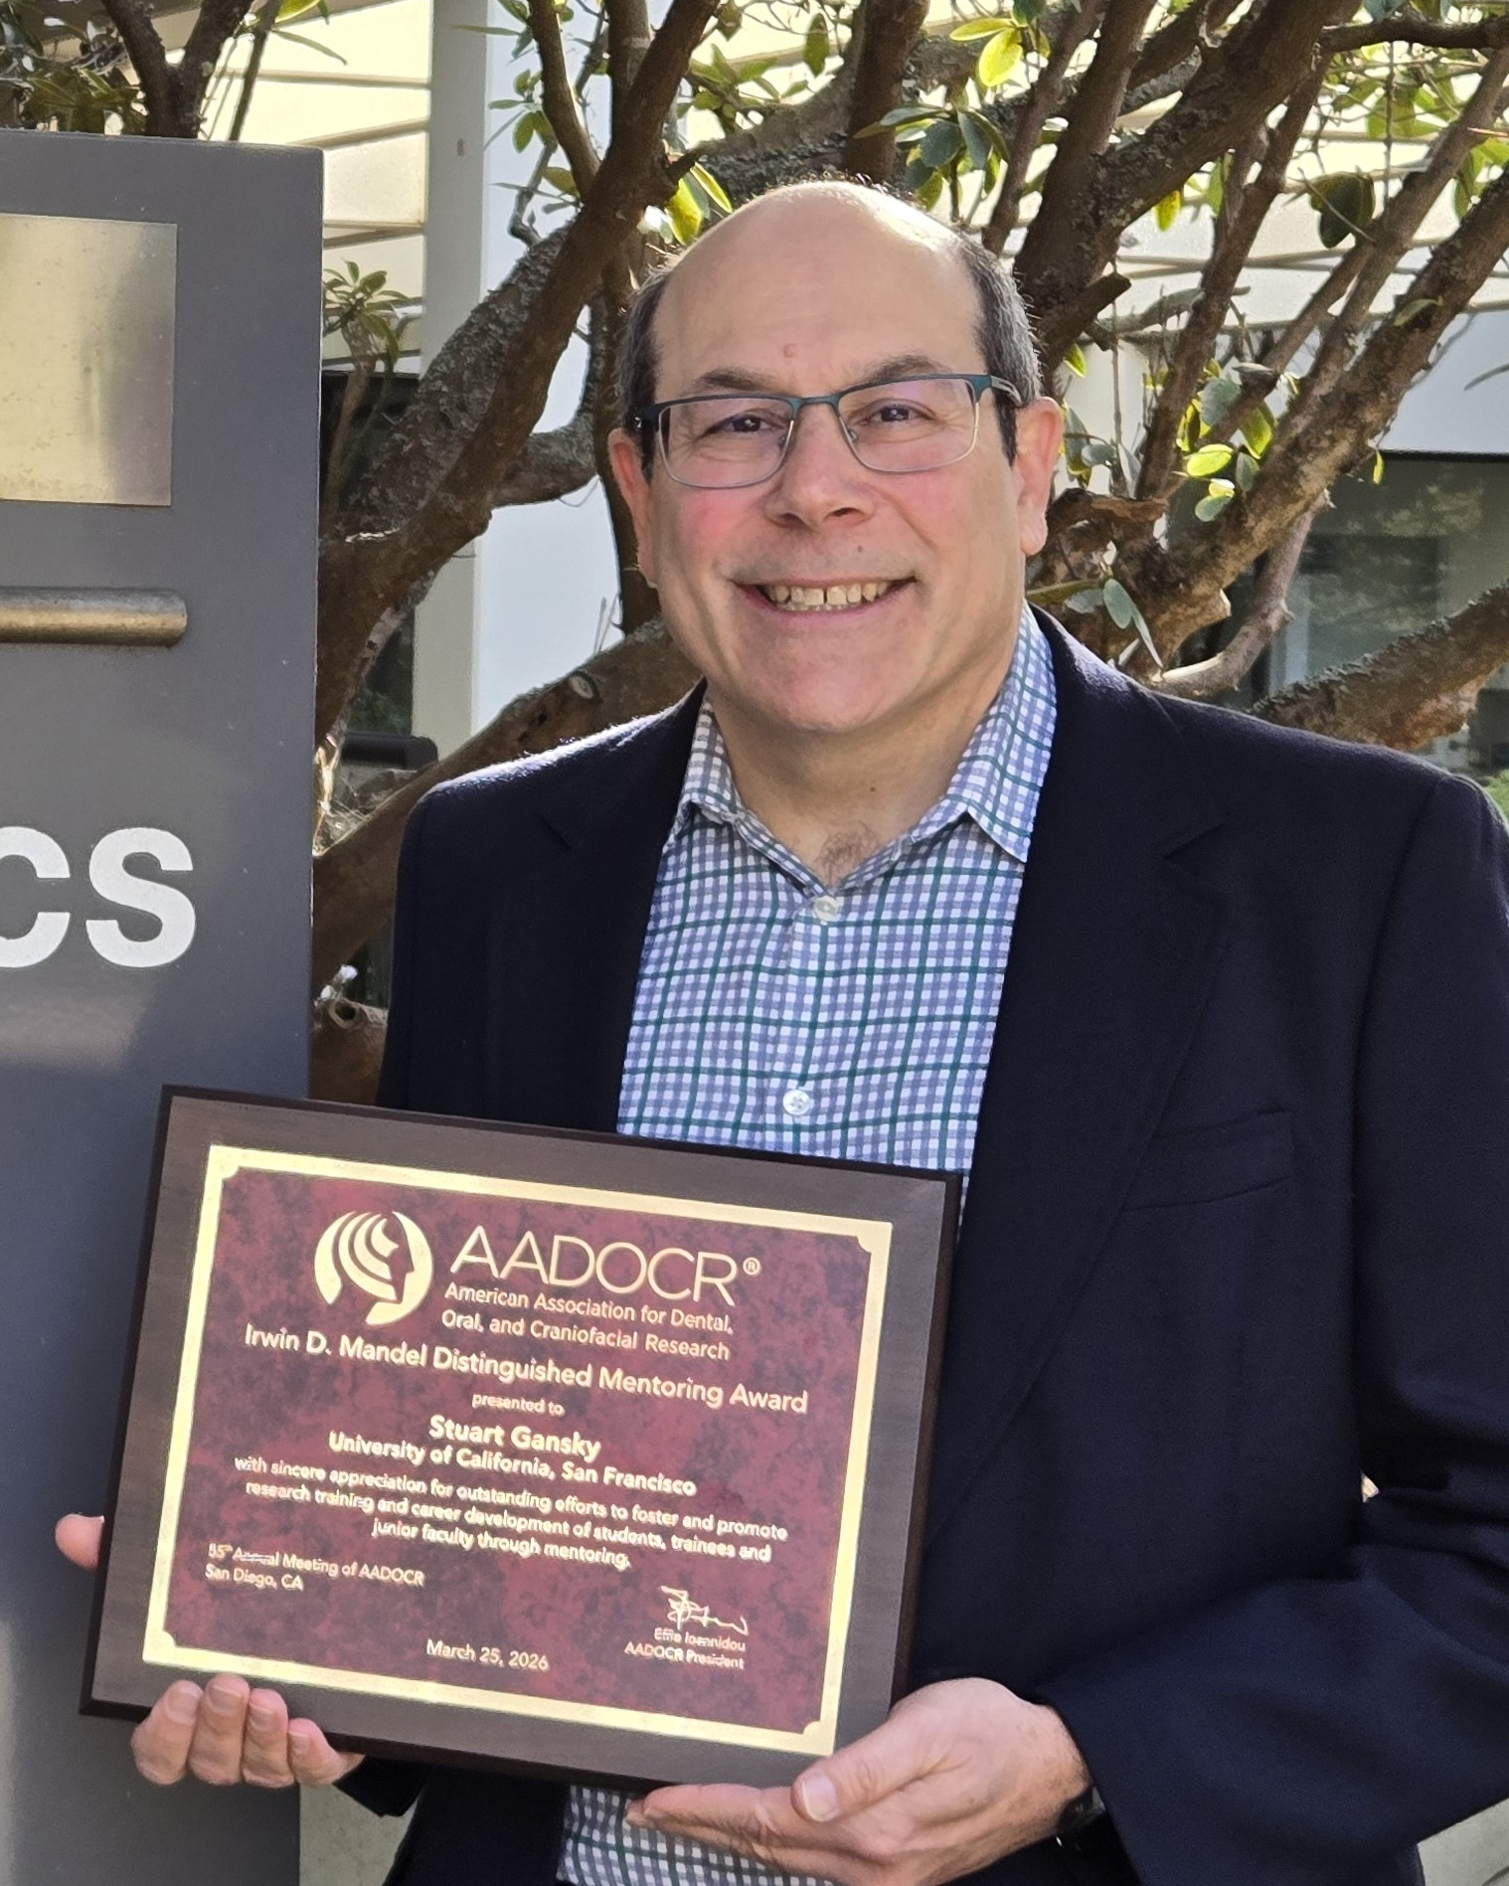
Awards and Fellowships
There are more than 40 awards and fellowships in various categories, including student awards.
AADOCR & IADR Distinguished Scientist Awards
Hatton Competition
  AADOCR: Junior, Senior, Post-doctoral
  IADR: Junior, Senior Clinical, Senior Basic Science
AADOCR Student Research Day Award
AADOCR Student Research Fellowships
AADOCR Student Competition for Advancing Dental Research and its Application (SCADA)
AADOCR Bloc Travel Grant Award
Scientific Group Awards
Notes:
Photo:
AADOCR/DDI Oral Health Equity Research Award Winner
Astha Singhal
Boston University, MA

Slide 12
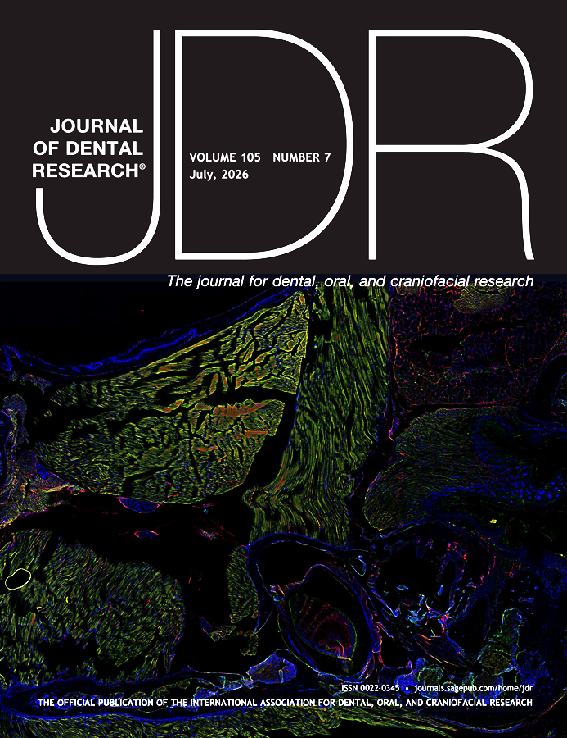
Journal of Dental Research
Editor-in-Chief: Nicholas Jakubovics
Journal Citation Reports™ 2025 results for the JDR:
  Total citations: 26,196, ranking #1 of 165
  Journal Impact Factor™: 6.6, ranking #5 of 165
  5-year Journal Impact Factor™: 7.8, ranking #5 of 165
  Article Influence Score: 1.640
  Eigenfactor: 0.01055
  Immediacy Index: 1.0
Published manuscripts appear in print and Online First, by which forthcoming articles are published online before they are scheduled to appear in print.
www.iadr.org/jdr
Follow the JDR on Twitter @JDentRes

Slide 13
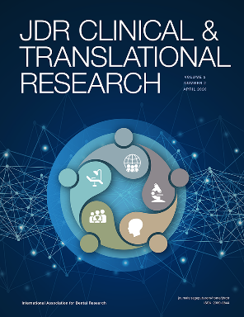
JDR Clinical & Translational Research
Editor-in-Chief: Jocelyne S. Feine
Journal Citation Reports™ results for the JDR CTR:
  Journal Impact Factor™: 2.0, ranking #81 of 165 journals
  5-year Journal Impact Factor™: 2.8, ranking #55 of 165 journals
  Article Influence Score: 0.586
  Eigenfactor™: 0.00114
  Immediacy Index: 0.4
Follow the JDR CTR on Twitter @JDRClinTransRes
www.iadr.org/jdrctr

Slide 14
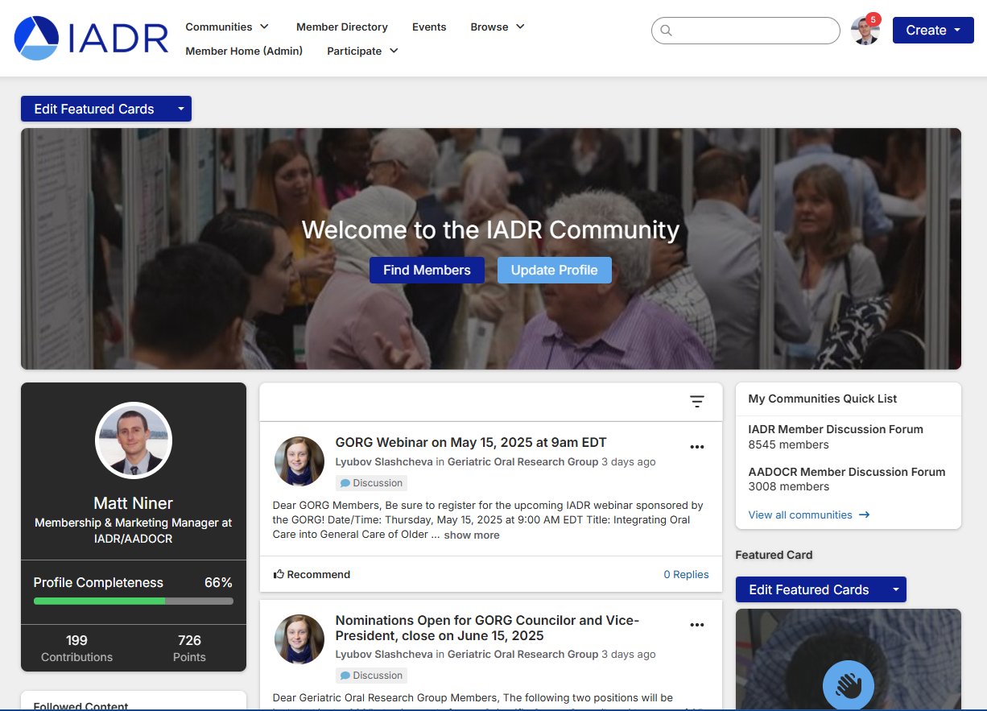
IADR Online Community
The IADR Online Community allows members to engage with their colleagues throughout the year.
Members can discuss hot topics, share insights, and post resources while building their worldwide professional network.
Notes:
The IADR Community is an online hub to meet and discuss research and other topics with your colleagues.

Slide 15
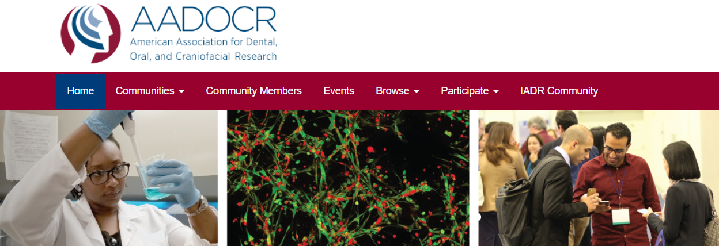
AADOCR Online Community
The AADOCR Community allows members to network, share, post, and comment on issues specific to the AADOCR.
Notes:
The new AADOCR Community allows members to network, share, post, and comment on issues specific to the AADOCR. To access the AADOCR Community, visit the IADR Community, click “ Communities” in the navigation bar and click “ My Communities.”

Slide 16
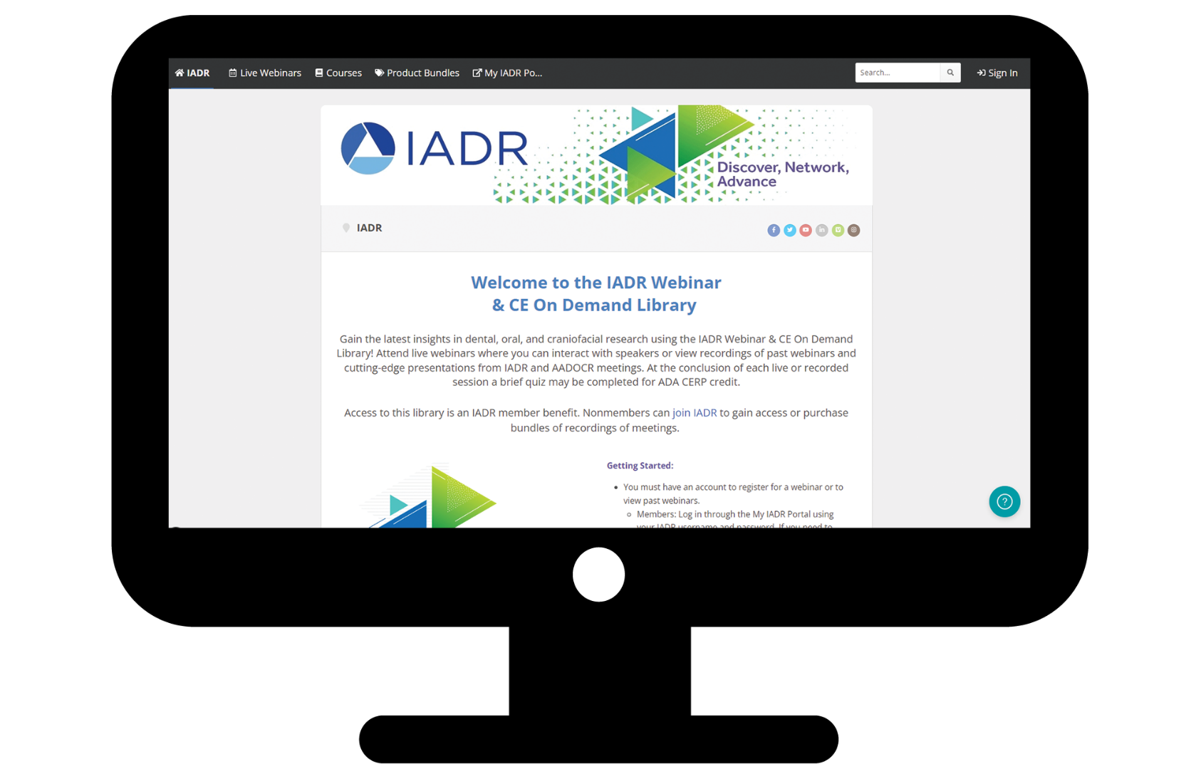
IADR Webinar & On Demand Library
Gain the latest insights in dental, oral, and craniofacial research using the IADR Webinar & On Demand Library! Attend live webinars, interact with speakers, and view recordings of past webinars and cutting-edge presentations from IADR and AADOCR meetings.
Notes:
The new IADR Webinar & CE On Demand Library allows IADR members to participate in live webinars and view our growing list of past webinars on demand!

Slide 17

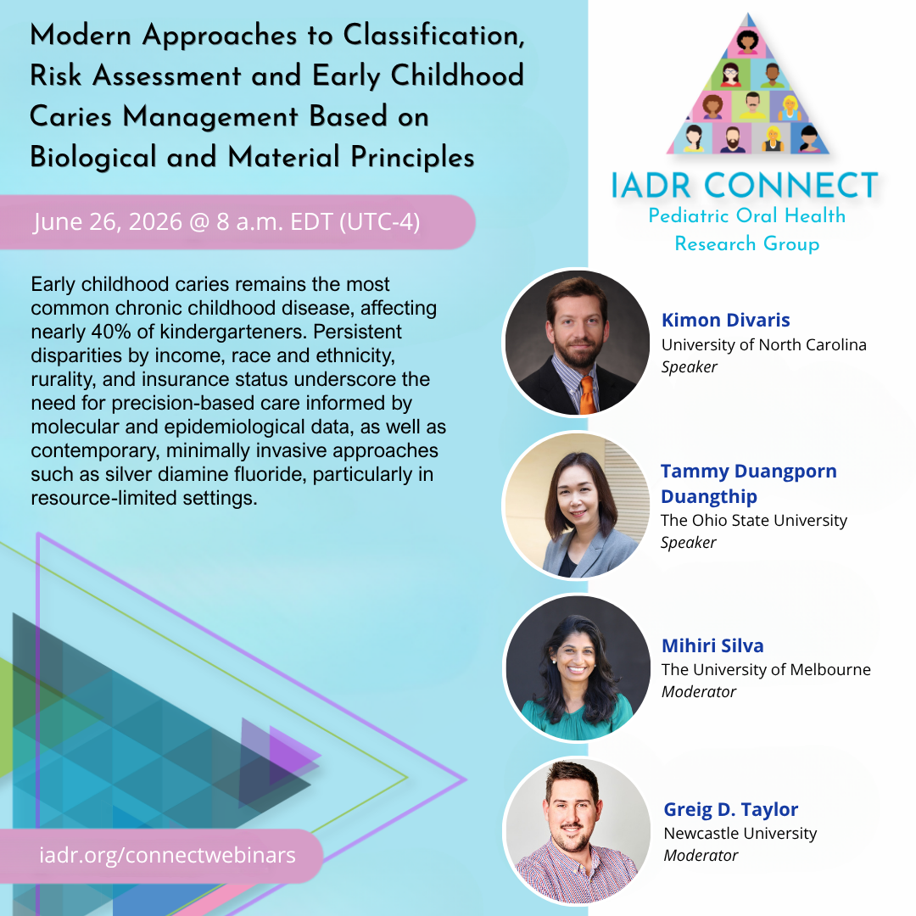
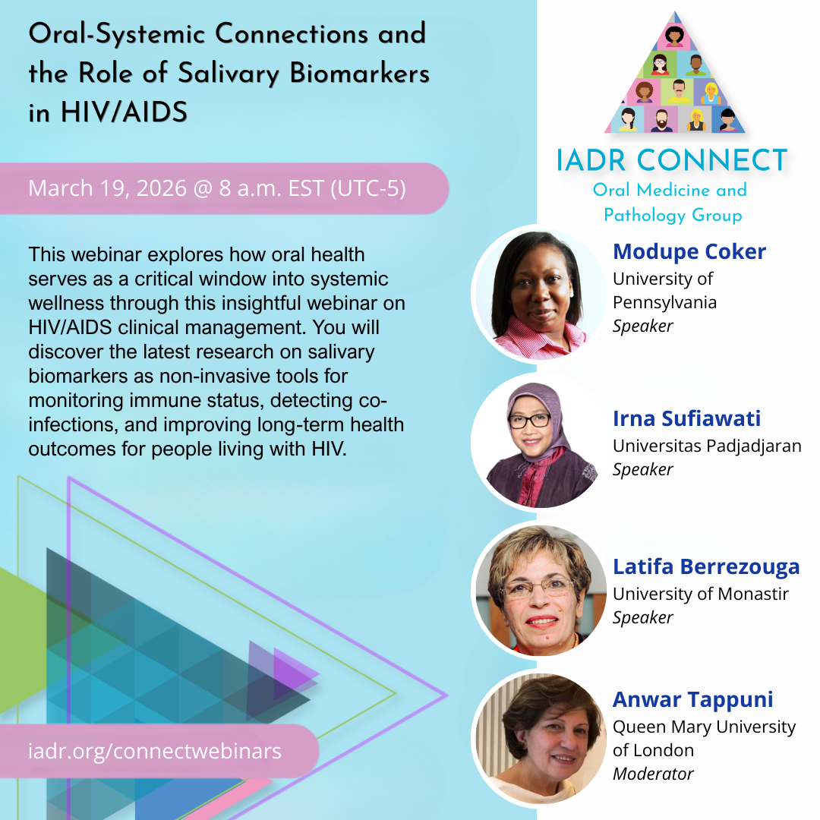
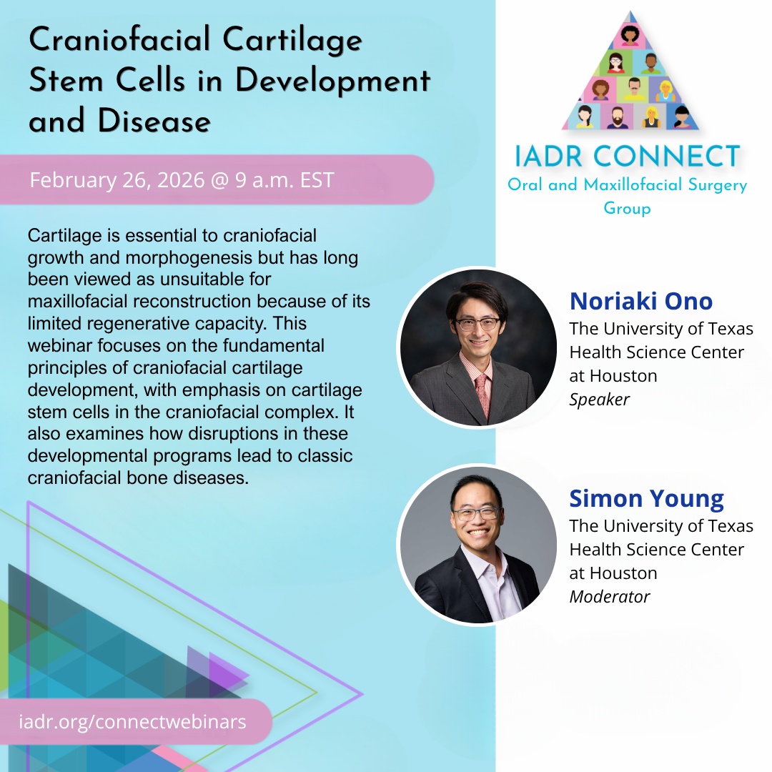
A Members-Only Webinar Series
by the IADR Scientific Groups & Networks

Slide 18

The AADOCR National Student Research Group is a student-run organization whose main purpose is to foster an environment in every dental school whereby students interested in enriching their dental education through research are encouraged to do so.
All AADOCR Student members are part of the AADOCR NSRG and are eligible to participate in NSRG activities.
The AADOCR NSRG provides students with opportunities to present research, apply for awards, and network at IADR/AADOCR meetings and throughout the year.
Learn more at https://www.aadocr.org/membership/students.
Notes:
The NSRG is a Scientific Group of the AADOCR composed of a network of self-governing local Student Research Group (SRG) chapters at dental schools and is led nationally by officers elected through a majority of votes from all members. All AADOCR student members are part of the AADOCR NSRG and are eligible to participate in their programs and activities.
Student members must join at least one IADR Group/Network and may join up to a total of three IADR Groups/Networks at no charge.

Slide 19
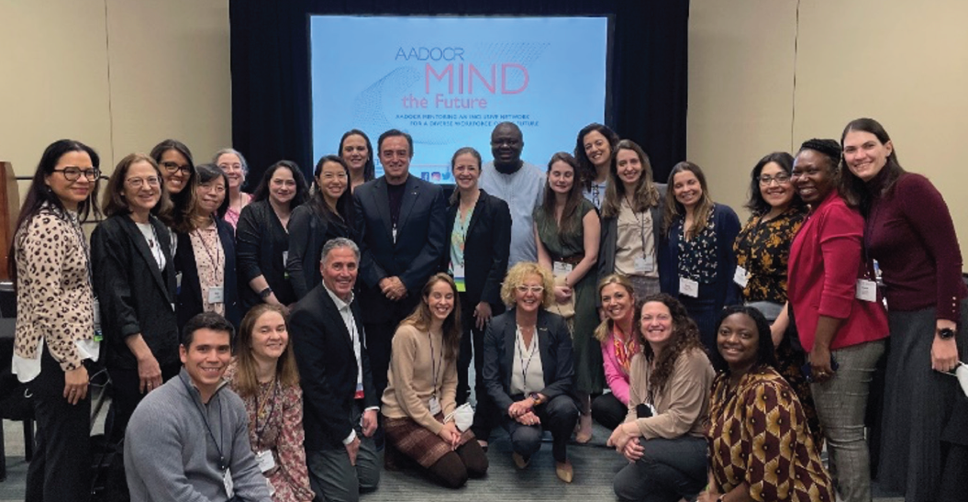

AADOCR Mind the Future
The first in-person AADOCR Mind the Future Business Meeting was held at the 2022 AADOCR Annual Meeting & Exhibition
AADOCR Mind the Future is developing a sustainable, nationally recognized mentoring network that enhances the career development of early-career DOC researchers with merit- based opportunities for all.
Notes:
MIND the Future is building a vibrant community of investigators whose participation is vital to advancing dental, oral, and craniofacial research and improving the oral health of our nation. The overarching goal is to develop a sustainable, nationally recognized mentoring network that enhances the career development of early-career DOC researchers with merit- based opportunities for all. (NIH Grant No. 1UE5DE029439).

Slide 20

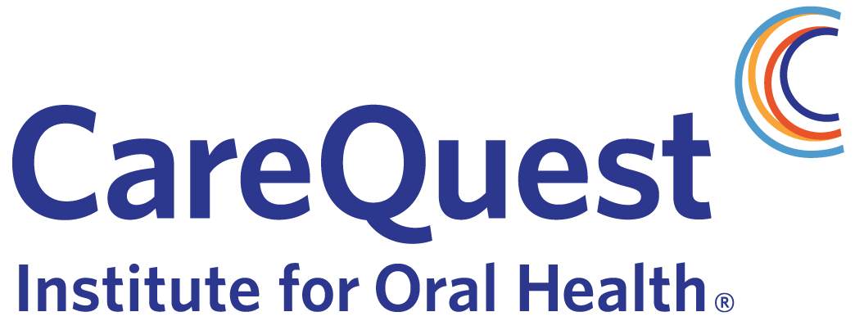
AADOCR Mind the Future
In 2020, AADOCR was awarded a five-year grant of more than $1.3 million by the National Institute of Dental and Craniofacial Research (NIDCR) in response to FOA RFA-DE-19-007. With this funding, the program was instrumental in fostering five cohorts of early-career investigators in the dental, oral, and craniofacial (DOC) research workforce.
In July 2025, AADOCR announced that it would continue the program for a sixth year, thanks to the support of CareQuest Institute for Oral Health. The program aims to continue to cultivate a robust pathway of future DOC researchers who can address critical scientific challenges.
“CareQuest Institute is proud to partner with AADOCR to ensure that early-career researchers have the mentorship and support they need to thrive,” said Eric Tranby, Senior Director of Analytics and Data Insights at CareQuest Institute for Oral Health. “Together, we’re investing in innovation and in the scientists whose work will help build a more equitable oral health care system and achieve better health outcomes.”
Notes:
MIND the Future is building a vibrant community of investigators whose participation is vital to advancing dental, oral, and craniofacial research and improving the oral health of our nation. The overarching goal is to develop a sustainable, nationally recognized mentoring network that enhances the career development of early-career DOC researchers with merit- based opportunities for all. (NIH Grant No. 1UE5DE029439).

Slide 21
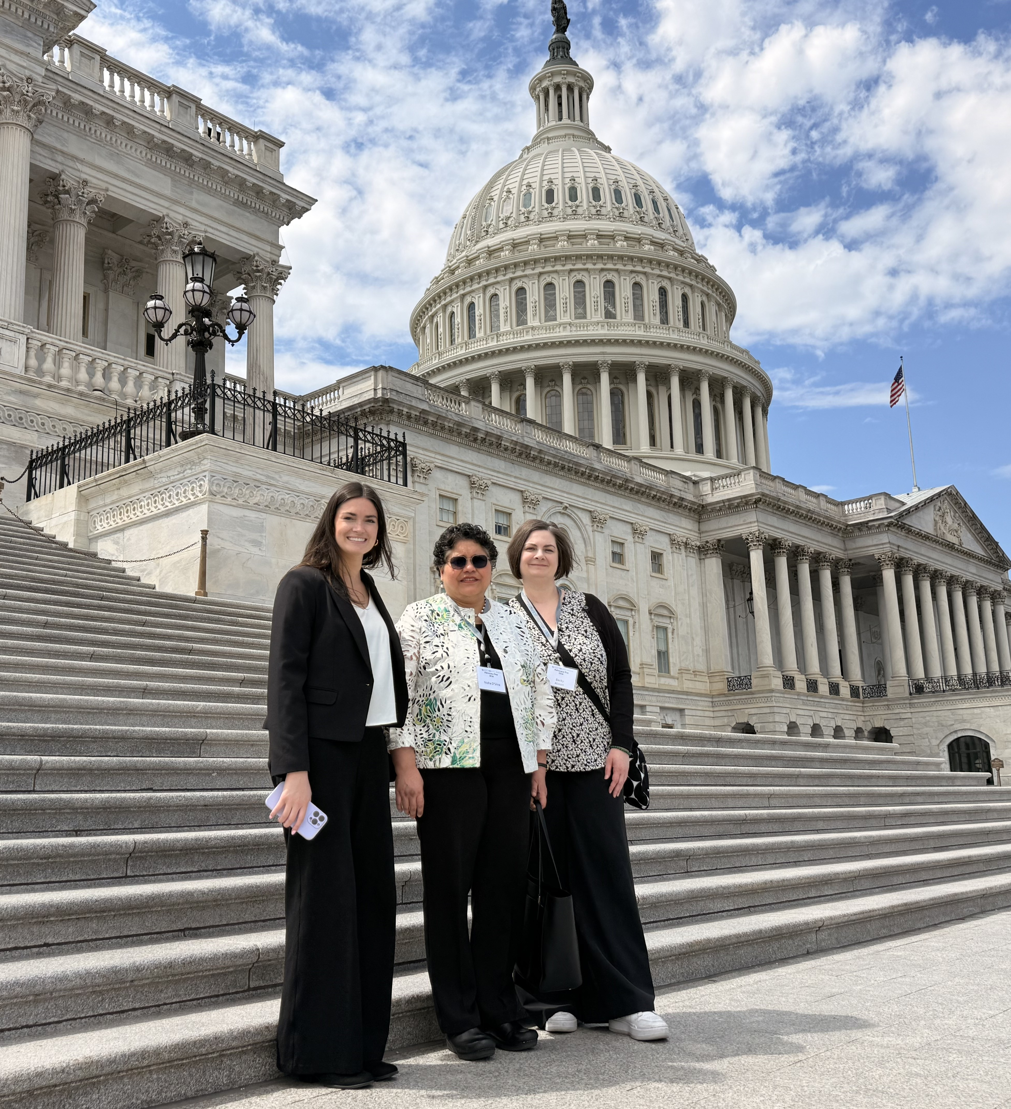
Government Affairs and Advocacy
AADOCR activities include:
Advancing dental, oral, and craniofacial research and funding among Congress and the administration.
Analyzing legislation and regulatory notices and ensuring dental, oral and craniofacial research is represented.
Engaging AADOCR members in grassroots advocacy efforts.
Co-hosting the annual “Advocacy Day” in Washington, DC to secure funding increases for oral health research agencies.

Slide 22
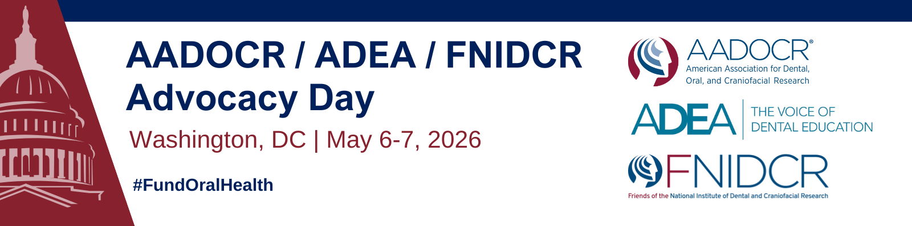
On May 6-7, 2026, oral health researchers and dental school faculty and students from around the country gathered at AADOCR’s annual Advocacy Day on Capitol Hill.
The annual event, in partnership with the American Dental Education Association (ADEA) and the Friends of NIDCR, provided an opportunity for the oral health science community to deliver a unified message to Congress that they must protect funding for oral health research and dental training and workforce programs.
Notes:
The Association actively engages with members of Congress, the administration and officials at the National Institutes of Health to promote AADOCR policy positions. AADOCR’s primary focus is increasing funding for the National Institutes of Health and the National Institute of Dental and Craniofacial Research so that our members are provided adequate resources to improve oral health through dental, oral and craniofacial research activities, but we also support oral health efforts across the federal research enterprise. The Association is an active partner with the ADA, ADEA and other dental groups and is involved in a number of coalitions focusing on areas of interest to AADOCR and our members. Beyond our external-facing work, a core part of our role is also to provide AADOCR members with information about potential implications of federal legislation and policies and give them the tools they need to respond to those that may impact their work.

Slide 23
AADOCR Board of Directors
  President
  Nisha D’Silva, University of Michigan
  President-elect
  Margherita Fontana, University of Michigan
  Vice-president
  Kimon Divaris, University of North Carolina at Chapel Hill
  Treasurer
  Julie Frantsve-Hawley, AT Still University
  JDR Editor-in-Chief
  Nicholas Jakubovics, Newcastle University
  JDR CTR Editor-in-Chief
  Jocelyne Feine, McGill University
  Patient Advocate
  Eileen Sexton, Head and Neck Cancer Alliance
  Members
  Modupe Coker, University of Pennsylvania
  Svetlana Farrell, Procter & Gamble
  Members-at-Large
  Hope Amm, Augusta University
  Mina Mina, University of Connecticut
  Tamanna Tiwari, University of Minnesota
  Student Representatives
  Drashty Mody, Indiana University
  Jonathan Banks, University of Illinois Chicago
  Chief Executive Officer
  Christopher H. Fox, IADR/AADOCR

Slide 24





Follow AADOCR on Social Media
AADOCR
@AADOCR
AADOCR
@AADOCR
@AADOCR.bsky.social
Notes:
Follow AADOCR on Social Media!

Slide 25
Contact Us
Visit www.iadr.org and www.aadocr.org for more information.
Questions about IADR/AADOCR membership, journals or meetings may be directed to memberservice@aadocr.org or 1.703.548.0066.

